Slide 1
Azores Genealogy Research Resources
Diane George April, 2016

Slide 2
Islands of the Azores
Corvo
Faial
Flores
Graciosa
Pico
São Jorge
São Miguel
Santa Maria
Terceira

Slide 3
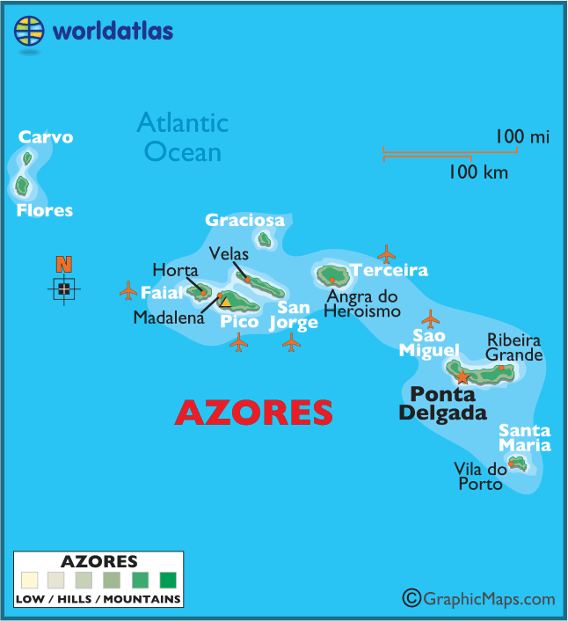
The Azores

Slide 4
Get the Records

Slide 5
Things to Remember
Wives do not take husbands’ surnames.
Children are not given a surname at birth.
Children do not necessarily use the surnames of either parent.
Surnames appear in marriage or death records.
Birthdates tend to be flexible.

Slide 6
CITCEM-University of Minho
Database compiled from church records for Pico, Faial and São Jorge.
Often referred to as “NEPS.”
Search by island and “frequesia.”
View in English by clicking on the British flag icon.
http://www.ghp.ics.uminho.pt/genealogias.html

Slide 7
CITCEM-University of Minho
Data does not include images
Individuals are linked to each other.
Generates ancestor and descendant reports.
There are mistakes!
Use the data as a starting point, but verify with other sources.
Names are converted to modern spellings.

Slide 8
Centro De Conhecimento Dos Açores
Referred to as “CCA.”
Digitized images of baptism, marriage, death and passport records.
Records are not indexed, but are grouped by type and years.
Data is not yet complete.
Documents are handwritten in Portuguese.
http://www.culturacores.azores.gov.pt/ig/registos/Default.aspx

Slide 9
Tombo.pt
Well organized site of links to the CCA database.
Makes searching for the records easier and quicker.
Has a link that translates the web site pages.
Also has some links to help with your research.
http://tombo.pt/d/acores

Slide 10
Ancestors from Other Islands
Get as much information as possible with dates and places.
Use the CCA site (Tombo).
Narrow the search with date information if possible, then
Search record by record.

Slide 11
Sample Baptism Record

Slide 12
Help Reading the Records

Slide 13
Azores Genealogy Google Group
Members help each other with transcriptions of church records.
Share information about ancestors, history and culture.
Help with travel information.
Find the group by going to Google. Search for Azores Genealogy group or use the link.
Join the group to receive messages.
https://groups.google.com/forum/?fromgroups#!forum/azores

Slide 14
Azores Genealogy Resources- Rootsweb
Collection of Resources for researching
Links to articles on reading records
Historical and geographical context information
Photos
Forum to query others about ancestors
http://www.rootsweb.ancestry.com/~azrwgw

Slide 15
Help Reading Portuguese Records
Azores Rootsweb site:
Includes sample images to review
Includes translations of the samples
http://www.rootsweb.ancestry.com/~azrwgw/HowTo_Part_3a.html#reading

Slide 16
Help Reading Portuguese Records
FamilySearch
Lessons include interactive slides
Word Lists
Month and day lists
https://familysearch.org/learningcenter/results.html?q=*&fq=place%3A%22Portugal%22

Slide 17
Translators
Google Translate -- http://translate.google.com
Bing Translator -- http://www.bing.com/translator/
Paste text from a document to translate it
Paste a URL to translate the entire web page
Be sure to review the translation before using
Names get translated

Slide 18
Other Sites
Geneall Portal of Genealogy--http://geneall.net/en/
Portuguese Roots Database--http://www.portugueseancestry.com/
Portuguese Genealogy--Doug Holmes website--http://www.dholmes.com/rocha1.html
LusaWeb--http://www.lusaweb.com/Home/tabid/36/Default.aspx
Family Tree DNA Azores Project--https://www.familytreedna.com/public/Azores/

Slide 19
More Sites
Portuguese Language Newspapers in the US-- http://www.lib.umassd.edu/paa/portuguese-american-digital-newspaper-collections
Cyndi’s List--http://www.cyndislist.com/portugal/
Nobiliário de Familias de Portugal--https://www.scribd.com/collections/4254114/Nobiliario-de-Familias-de-Portugal

Slide 20
Feliz Pesquisa!
(Happy Searching-At least that’s what Google Translator says it means)

